Slide 1


Welcome to English for Programming
Week 1 Class 1
Programmers made by StorySet> <a href="https://storyset.com/web">Illustration by Freepik Storyset</a>

Slide 2
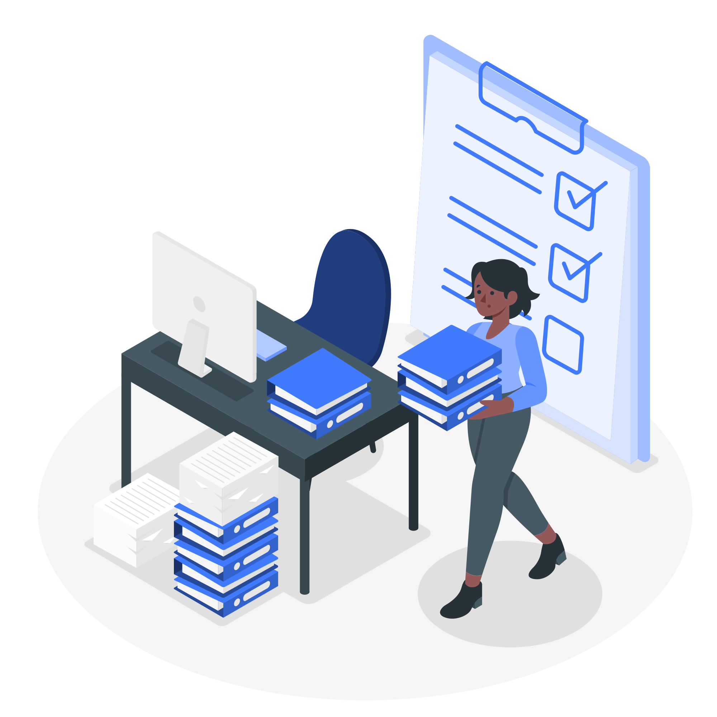



Topics for today
Course Introduction
Get to know each other
English, here we come!
<a href="https://storyset.com/work">Illustration by Freepik Storyset</a>

Slide 3


Objetivo General
Apoyar a los estudiantes en las lecturas específicas de los materiales del curso de programación
Coding made by StorySet> <a href="https://storyset.com/web">Illustration by Freepik Storyset</a>

Slide 4
Objetivos Específicos
Brindar a los estudiantes las estrategias de lectura aplicables a diferentes tipos de textos de programación
Comprender y seguir instrucciones sencillas relacionadas con los lenguaje y métodos de programación
Lograr interacción básica en inglés en contextos cotidianos relacionados con su campo
Afianzar vocabulario técnico en inglés alineado con Python
Desarrollar competencias lingüísticas en inglés alineadas con el nivel A2 del Marco Común Europeo de Referencias (MCER)

Slide 5
Temáticamente alineado con sus cursos de coding
4 Ciclos
1 Ciclo=7 Semanas
Gramática Funcional
Habilidades comunicativas nivel A2 situadas en el contexto
Retos de Lectura Reading Challenges
What is English for Programming?
25 horas de clase cada uno

Slide 6
¿En qué consiste cada ciclo?
 | Clase Sincrónica 2 horas | Refuerzo Asincrónico Interactivo | Clase Sincrónica 2 horas | Refuerzo Asincrónico Interactivo
Semana 1 | Class | My learning Menu | Class | My Learning Menu
Semana 2 | Class | My Learning Menu | Class | Reading Challenge 1 (calificable)
Semana 3 | Class | My Learning Menu | Class | Reading Challenge 2 (calificable)
Semana 4 | Class | My Learning Menu | Class | Reading Challenge 3 (calificable)
Semana 5 | Class | My Learning Menu | Class | Reading Challenge 4 (calificable)
Semana 6 | Class | My Learning Menu | Examen
Semana 7 | Retroalimentación /Feedback

Slide 7
Sincrónico
Asincrónico
¿Cómo se conecta el contenido sincrónico con lo asincrónico?
Gramática funcional
Profundizar en los temas léxico-gramaticales trabajados en clase
Habilidades de escucha
Interacción básica en ambientes laborales
Estrategias de lectura
Pronunciación
Retos de Lectura aplicados a Python
Vocabulario

Slide 8
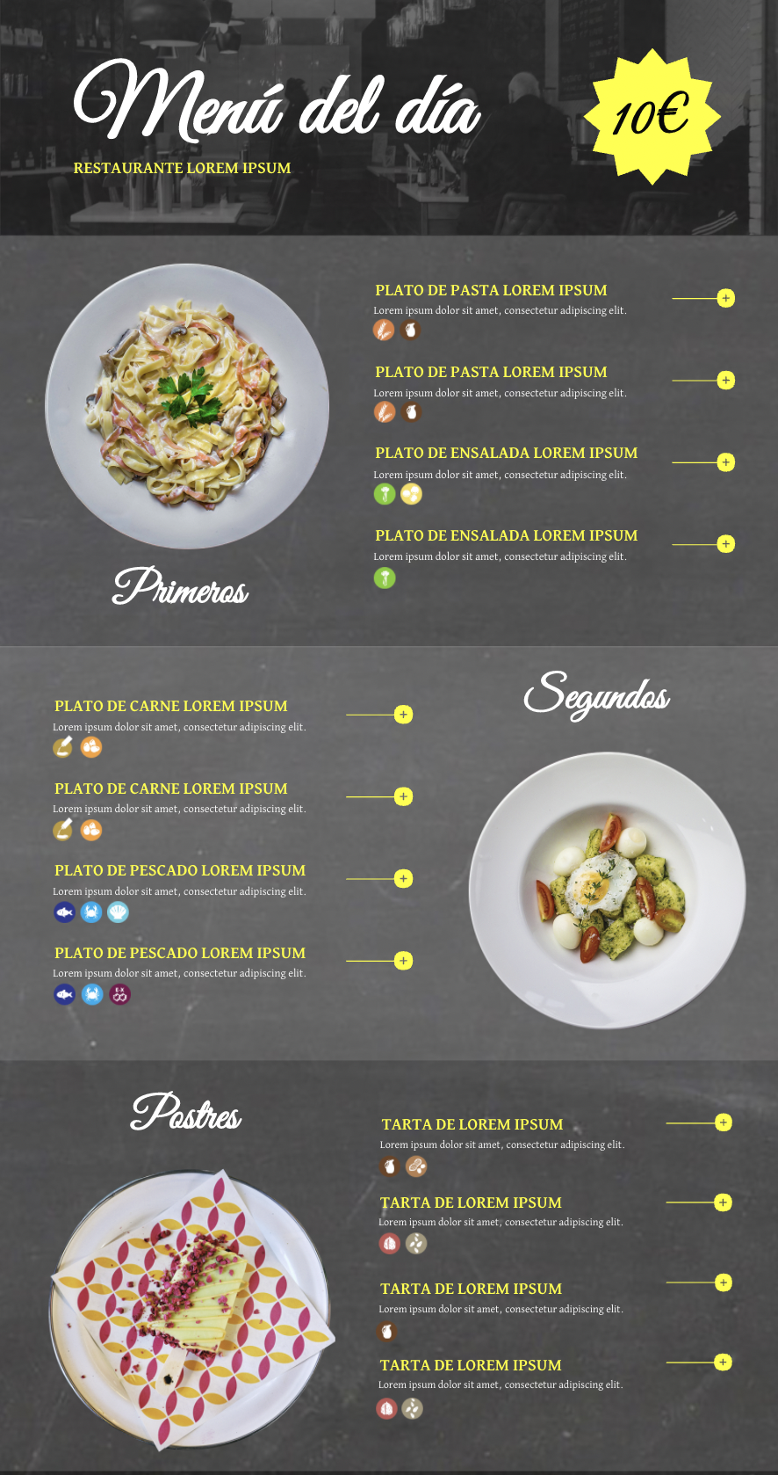
Pero,
¿Qué es un Learning Menu?
La entrada o Appetizer. Esta actividad te permite profundizar en los temas trabajados en la clase sincrónica.
El plato fuerte o Main Course (una o varias actividades obligatorias). Estas actividades te brindan input sobre las estrategias de lectura y su aplicación.
El postre o Dessert. Esta actividad te brinda vocabulario propio del campo IT. SE llama IT Survival English y es opcional

Slide 9
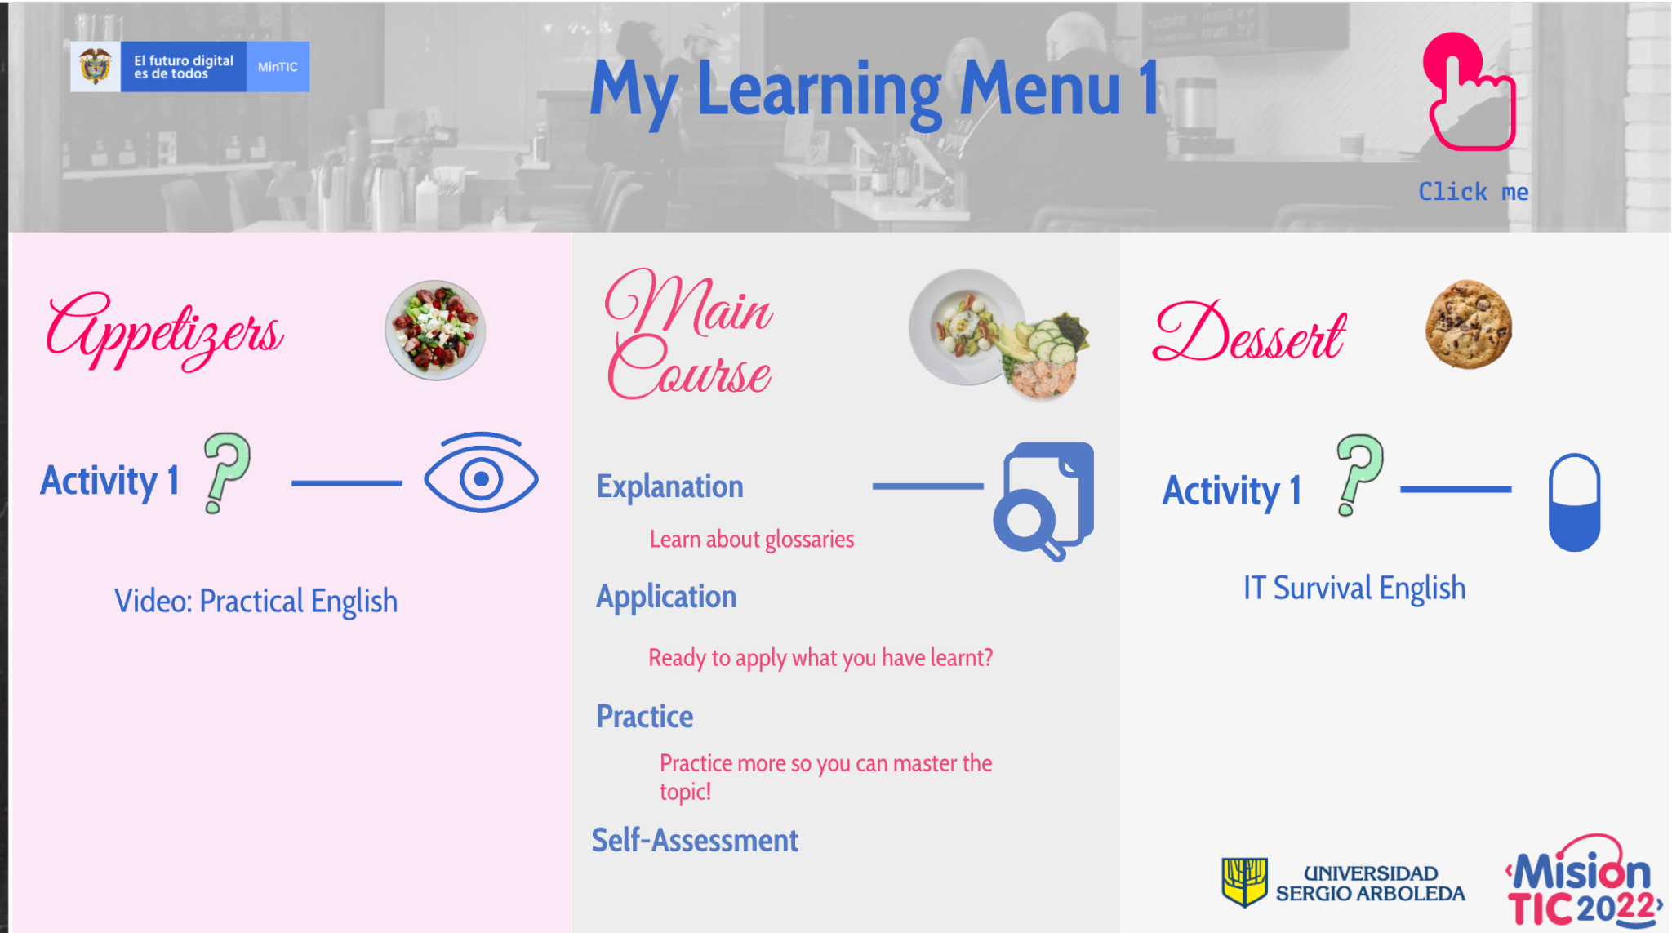
Explorar My Learning Menu
Notes:
Here, it is paramount that T opens the genially menu and explores it with students. Tell students to go to mastertech and check it. T explains how they know if they should click-activate interactive elements in the upper right corner.
https://view.genial.ly/607af977c54e6b0d0da68847

Slide 10
¿Cómo me van a evaluar?
Ciclos Nivel A2 | Examen Final del Ciclo | Retos de Lectura (Reading Challenge) | Total % por Ciclo
English for Programming 1 (25 horas/ 7 semanas) | 1 examen final Lectura aplicada a la programación, contenido léxico-gramatical y funciones (60%) | 4 retos (40%, cada uno 10%) | 100%
English for Programming 2 (25 horas/ 7 semanas) | 1 examen final Lectura aplicada a la programación, contenido léxico-gramatical y funciones (60%) | 4 retos (40%, cada uno 10%) | 100%
English for Programming 3 (25 horas/ 7 semanas) | 1 examen final Lectura aplicada a la programación, contenido léxico-gramatical y funciones (60%) | 4 retos (40%, cada uno 10%) | 100%
English for Programming 4 (25 horas/ 7 semanas) | 1 examen final Lectura aplicada a la programación, contenido léxico-gramatical y funciones (60%) | 4 retos (40%, cada uno 10%) | 100%

Slide 11
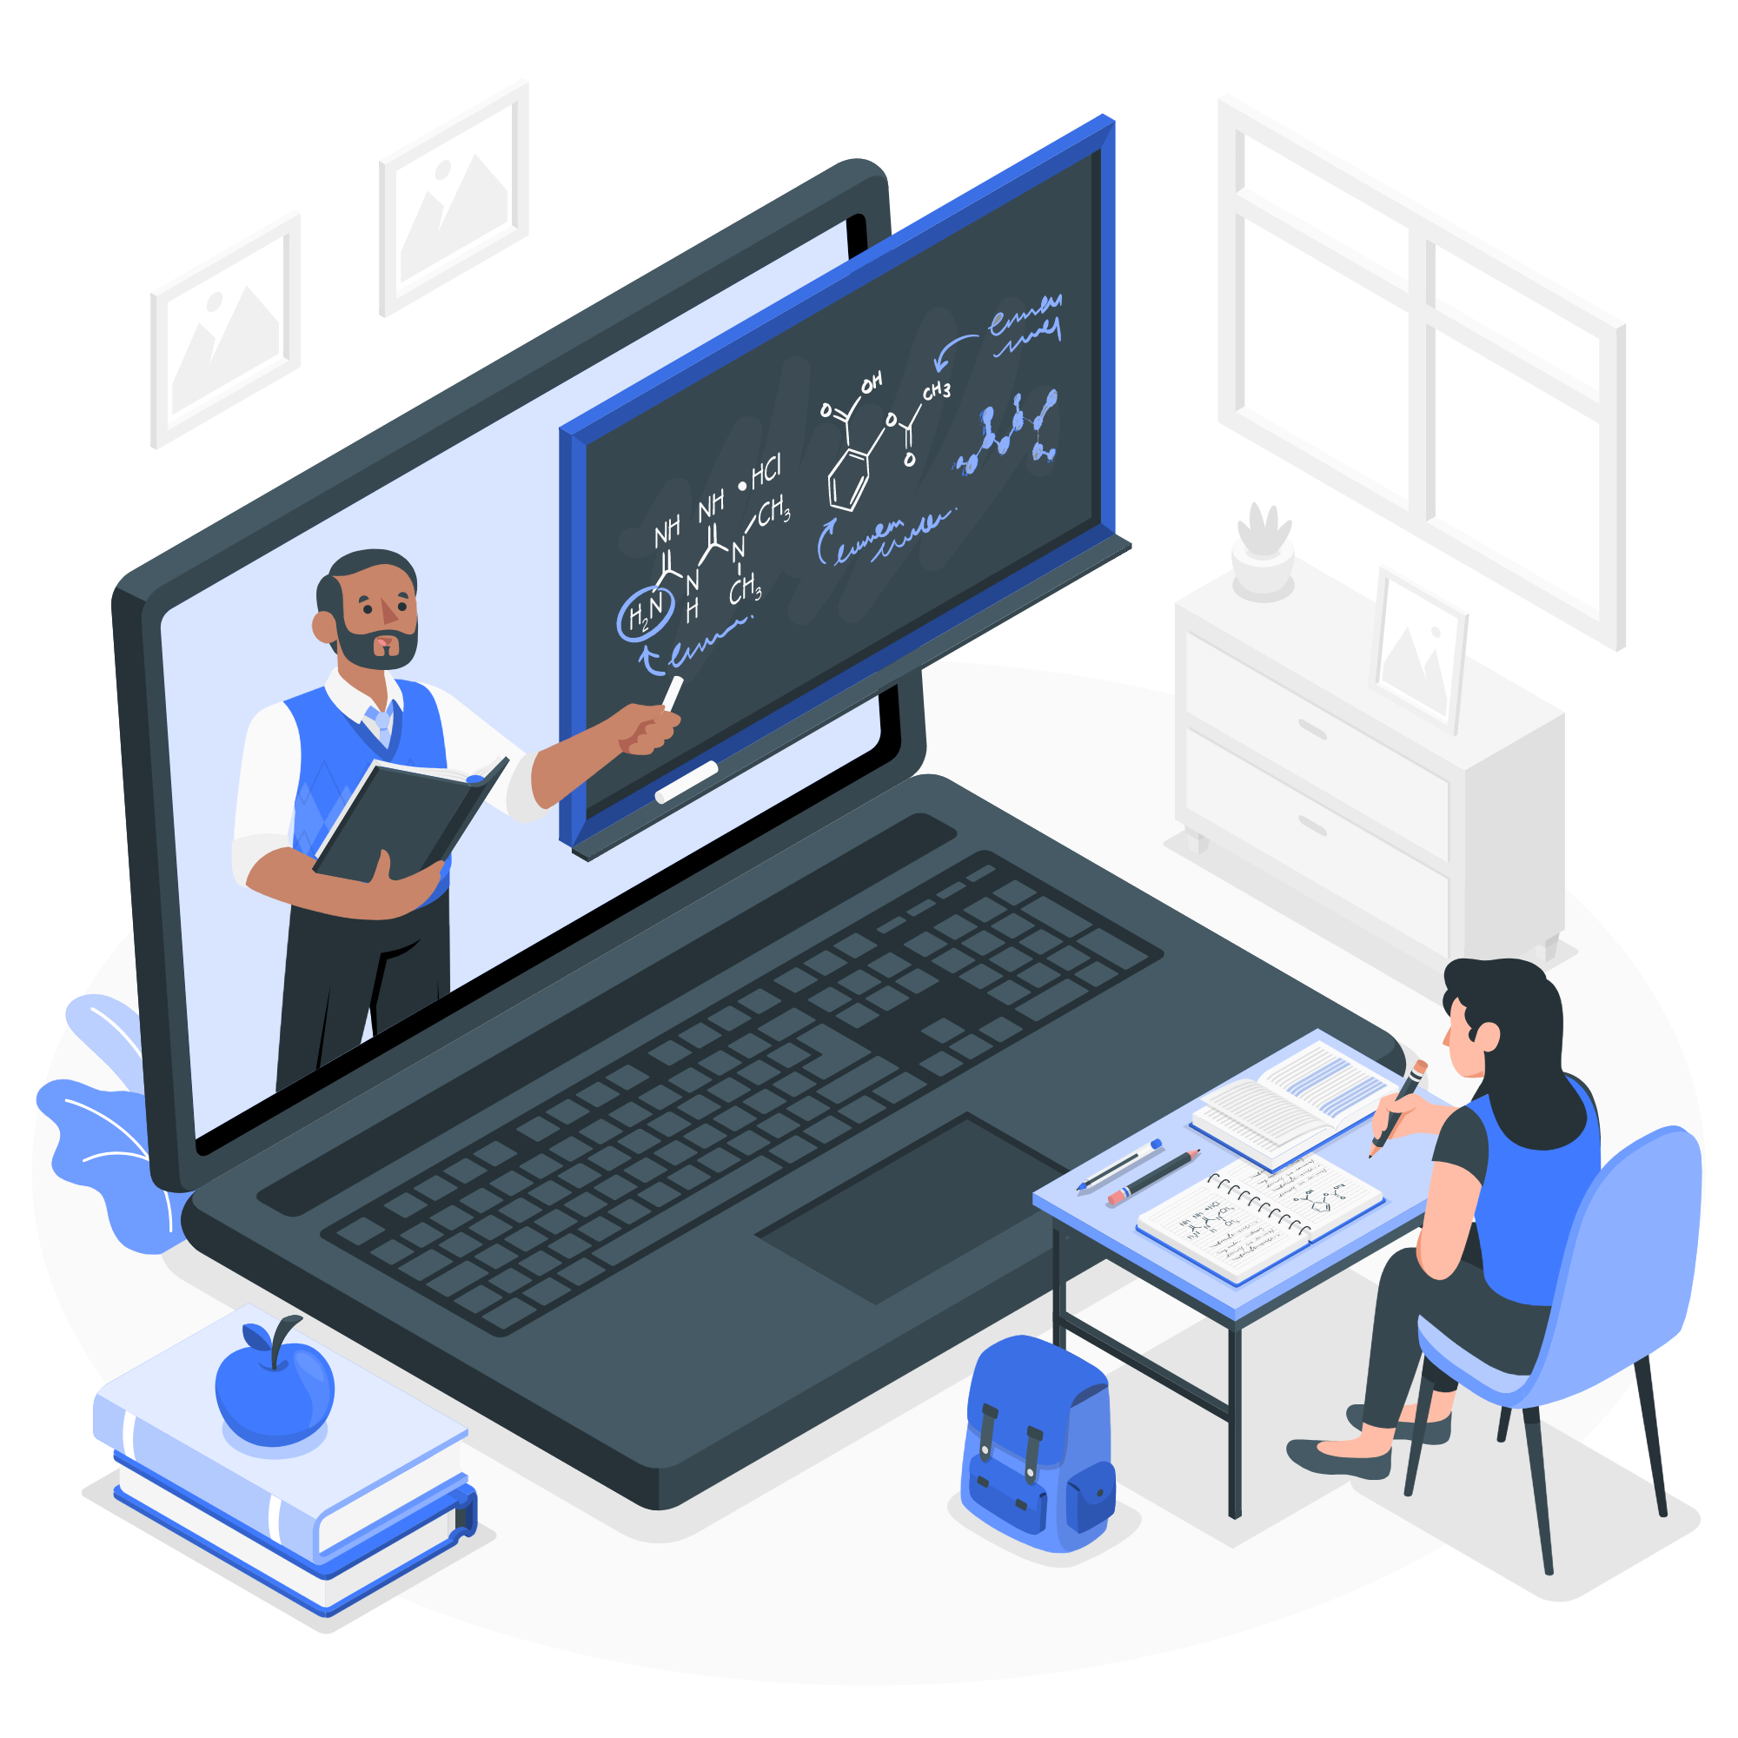
Retos de Lectura
Cada ciclo contiene 4 retos de lectura calificables.
Son textos sobre la programación en Python de su curso
Cada Menú de Aprendizaje (Learning Menu) incluirá un reto de lectura de práctica (no calificable)
Al inicio de cada semana, encontrarás un mensaje en tu plataforma MasterTech que te informa sobre las tareas calificables y los objetivos semanales.
Online made by StorySEt> <a href="https://storyset.com/online">Illustration by Freepik Storyset</a>

Slide 12
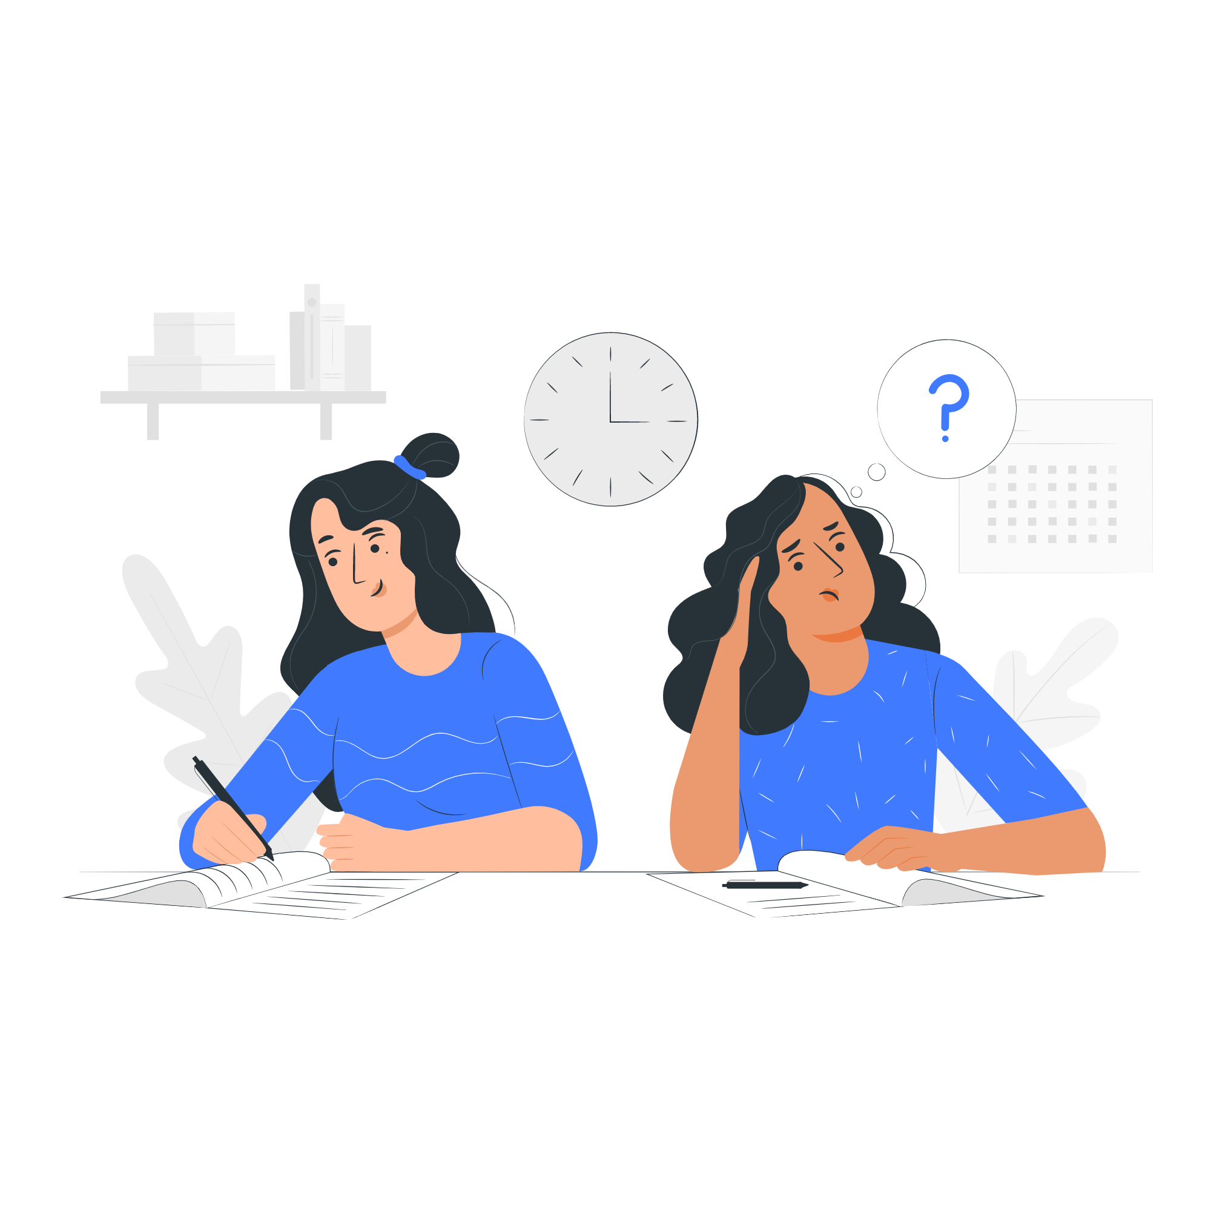
Let’s see how much we understood
Quiz Time!
Exam SemiFlat createt by StorySet:<a href="https://storyset.com/education">Illustration by Freepik Storyset</a>
Notes:
Here, T opens a kahoot or menti y checks understanding of the course characteristics. Esta parte se puede en español. Preguntas sugeridas son:
Cuantas horas sincrónicas tiene el curso English for Programming 1? 50 25 15
My learning Menu se trabaja de manera a. sincrónica b. asincrónica
Cual de los siguientes materiales es obligatorio: a. Appetizer b. Main Course c. desser
Cual parte del Menu contiene la práctica de lectura? Appetizer Main Course Dessert
Reading Challenges tienen un valor de 5 % 10 % 15 % de la nota
El nivel de inglés corresponde a A1 A2 B1
El vocabulario técnico está alineado con Python - Verdadero Falso
El examen final tiene un valor de 30% - Verdadero o Falso

Slide 13

Coffee break
5 min
Coffe Break bu StoruSet: <a href="https://storyset.com/people">Illustration by Freepik Storyset</a>
Notes:
Here, T opens a kahoot or menti y checks understanding

Slide 14
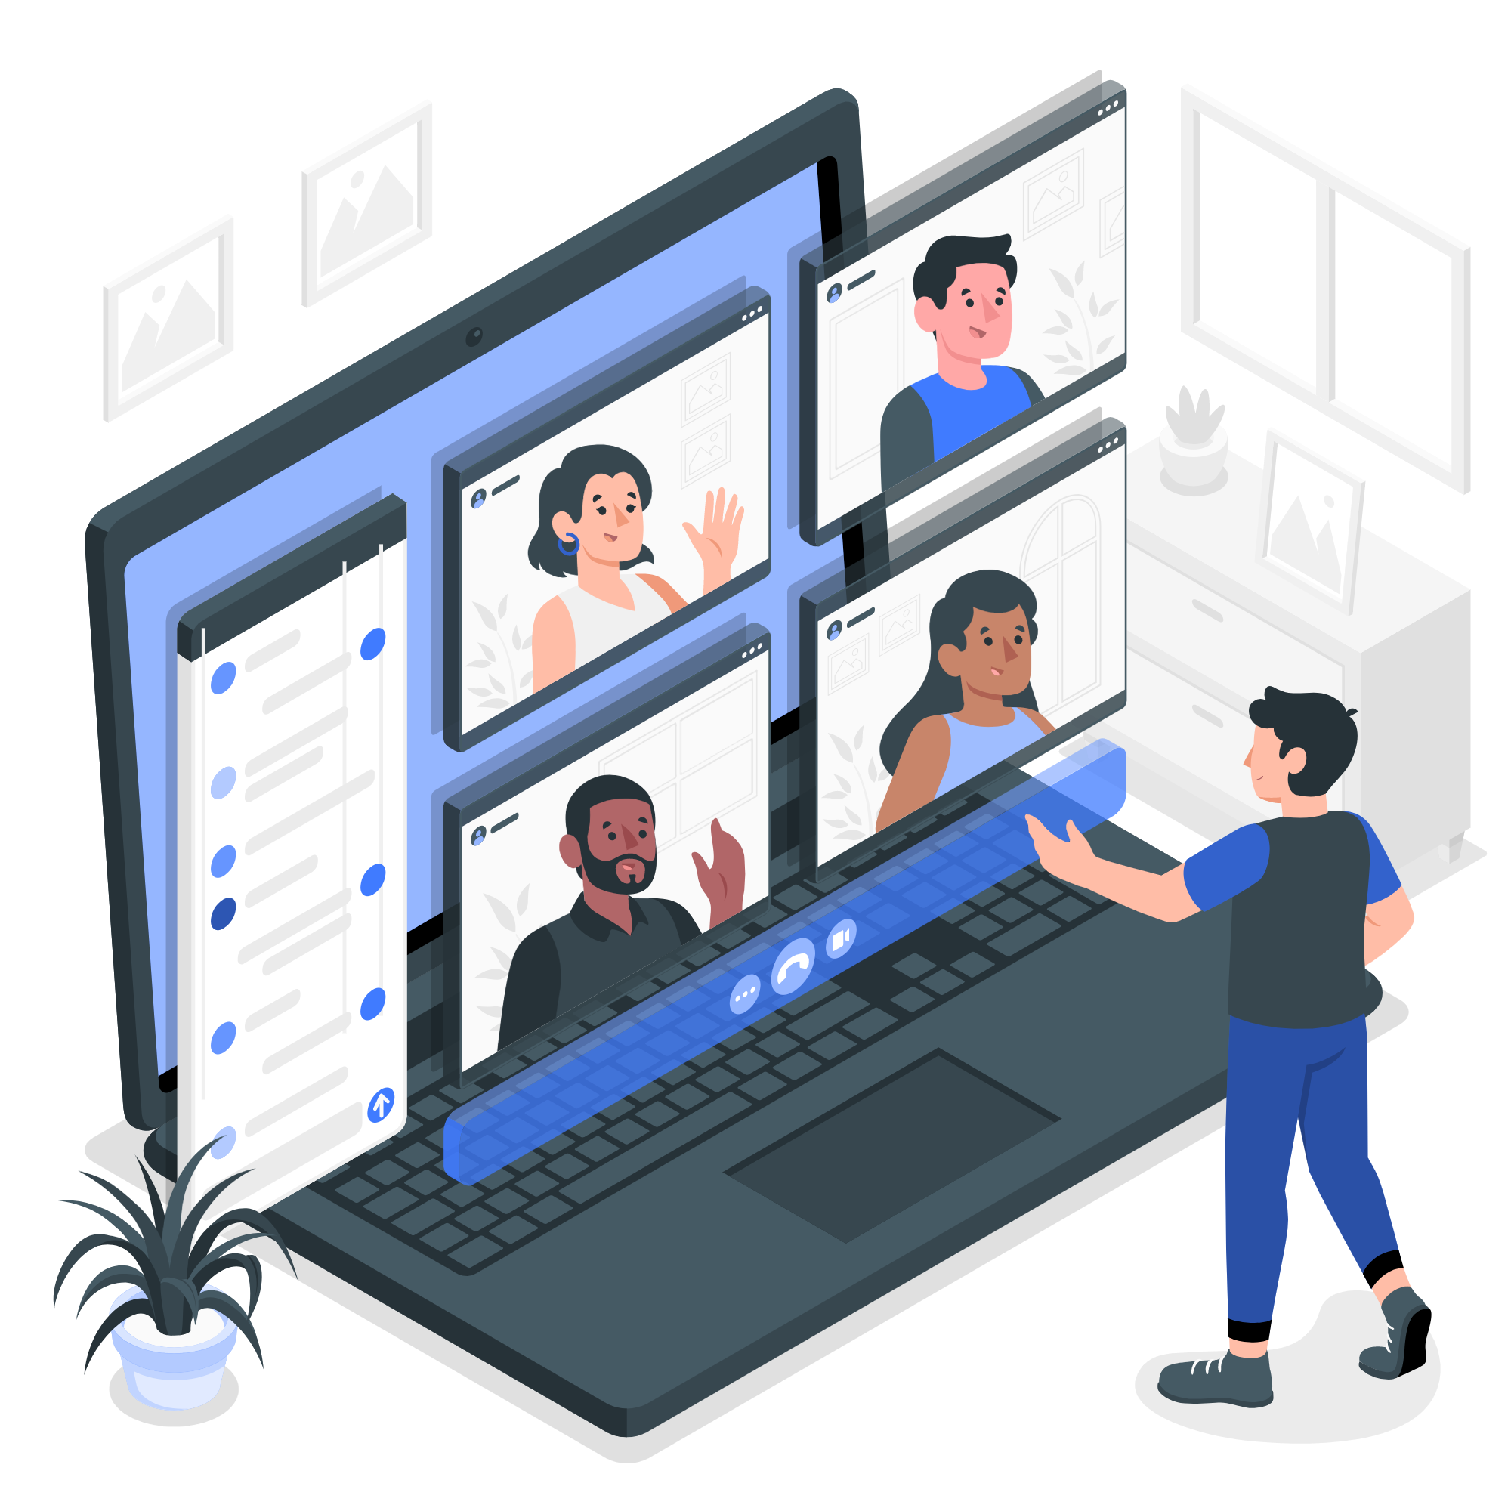
English for Programming 1, here we come!
Lesson 1
Online group made by StorySet> <a href="https://storyset.com/people">Illustration by Freepik Storyset</a>

Slide 15




Let’s get to know each other
What is your dream job?
Post your name next to it.
We will vote on the best dream job!
<Hello made by StorySet> a href="https://storyset.com/work">Illustration by Freepik Storyset</a>
Notes:
Here, T creates a jamboard or padlet. SS post and T shares screen to comment. The final task in this lesson is group work where students will create a description of one dream job based on what they posted here. 5 min

Slide 16

Topics
By the end of the class, you will be able to…
Greet in English
Introduce yourself and others
Describe a person and his/her job
Goal Cartoon Illustration made by Storyset: <a href="https://storyset.com/business">Illustration by Freepik Storyset</a>

Slide 17

Greetings

Slide 18
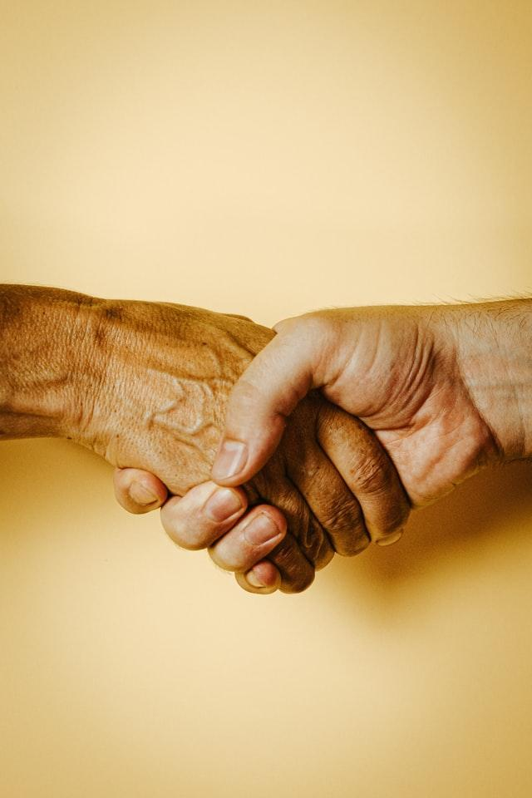

How do you greet people in your country?
In Colombia, people…
What do they say?
Hug
https://unsplash.com/photos/9vHPCKymSh0?utm_source=unsplash&utm_medium=referral&utm_content=creditShareLink
Shake hands
https://unsplash.com/photos/JNwba6cv4e0?utm_source=unsplash&utm_medium=referral&utm_content=creditShareLink

Slide 19

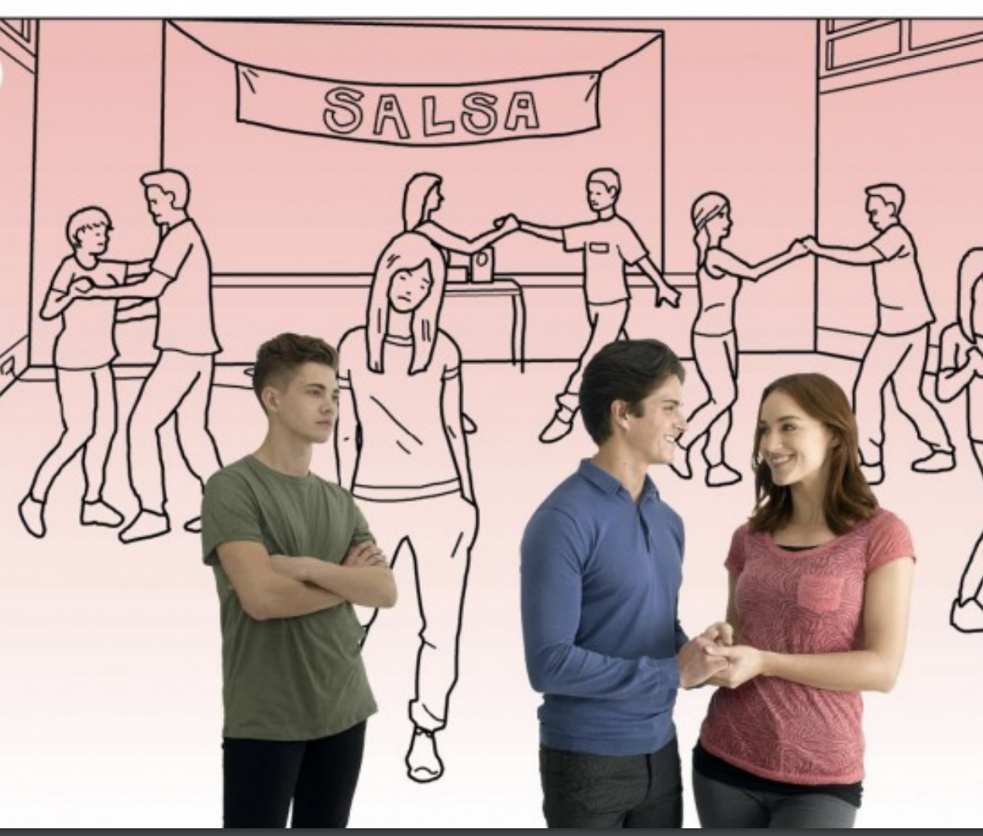
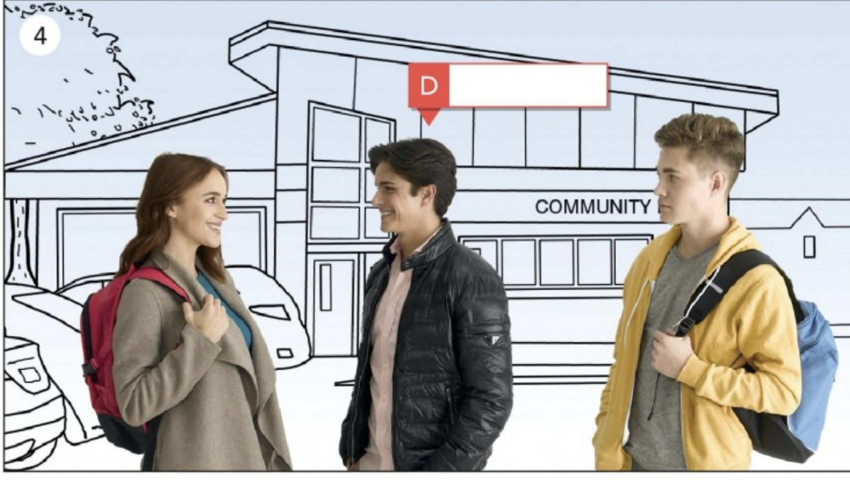
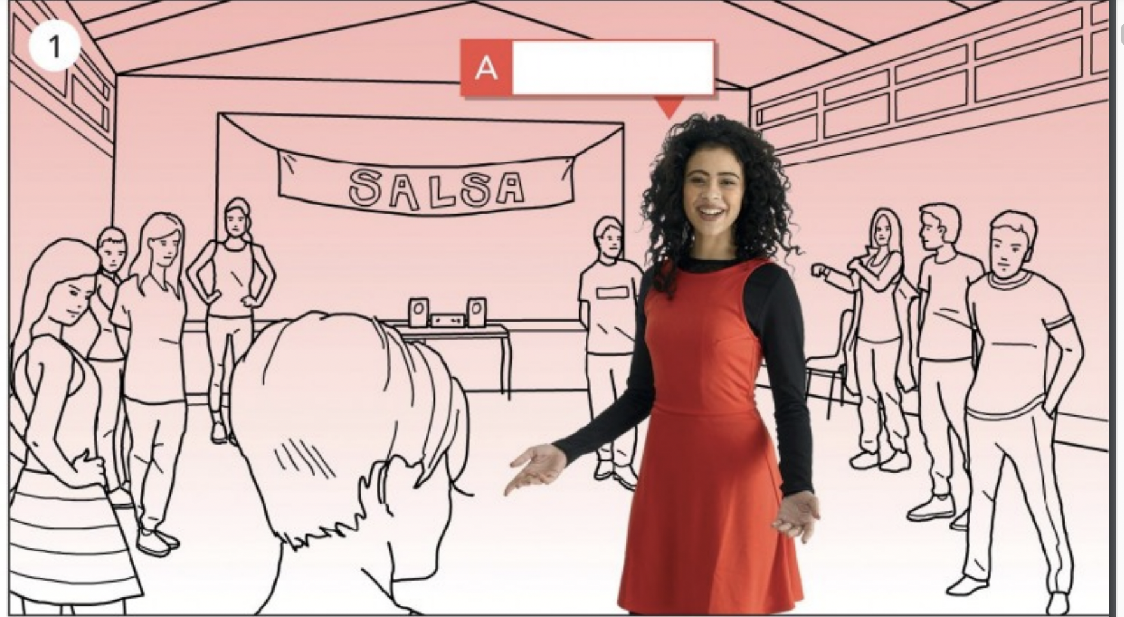
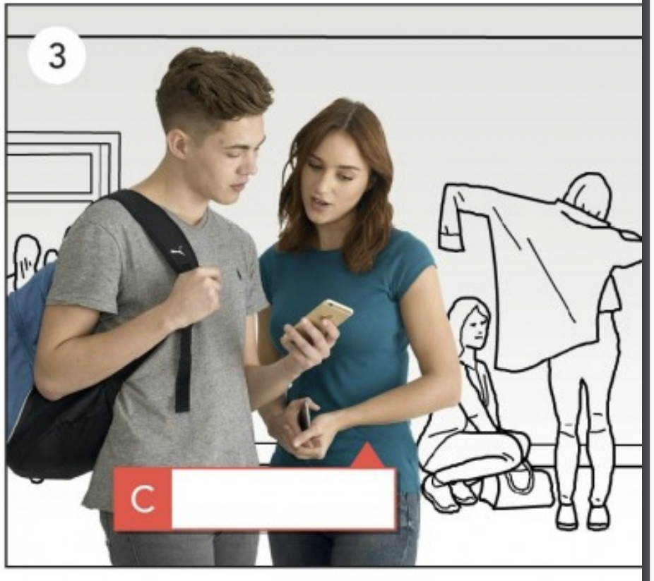
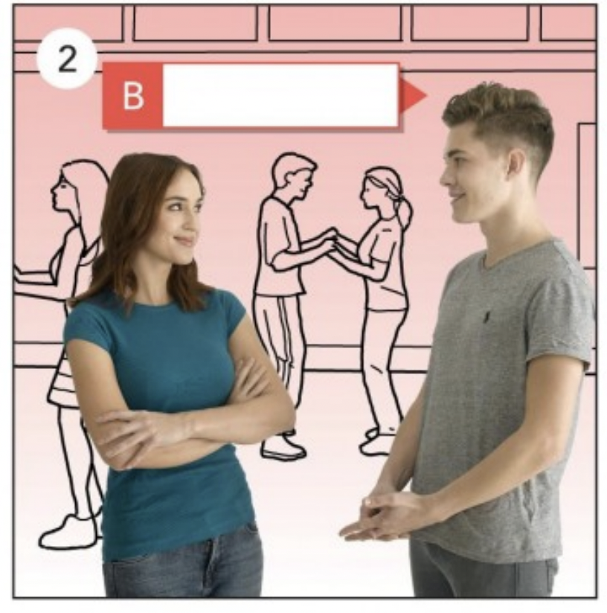
Listen and match
Listen to the story and number them in the correct order, from 1-5.
Notes:
Recording 1

Slide 20
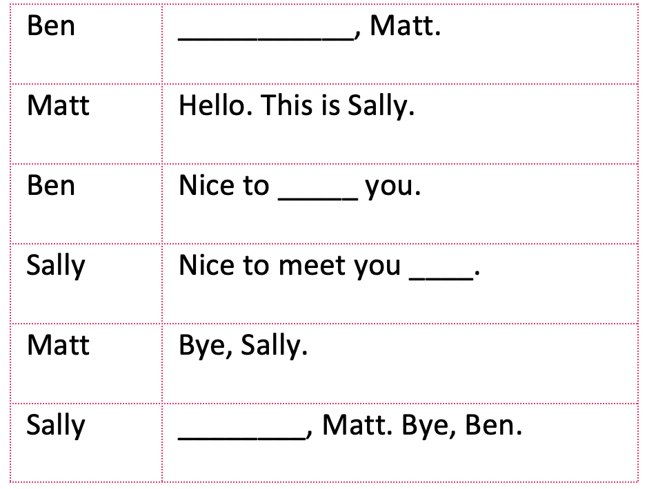
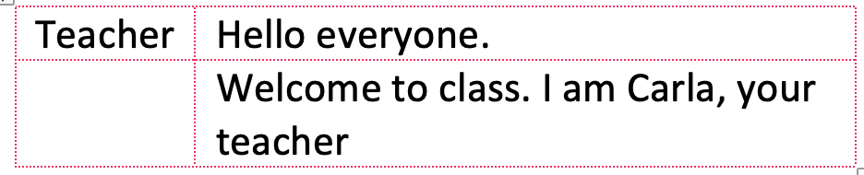
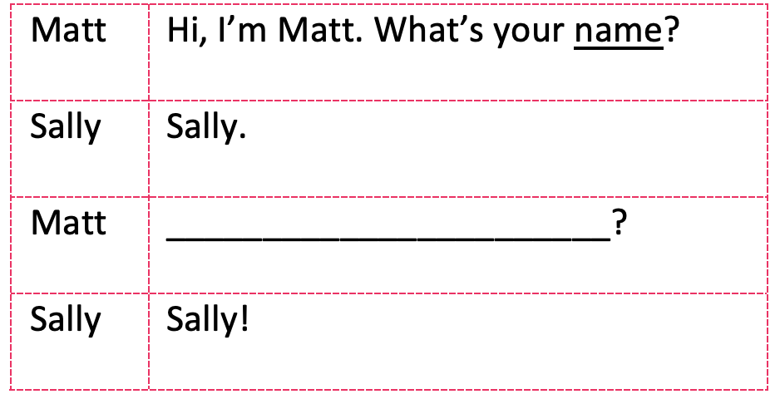
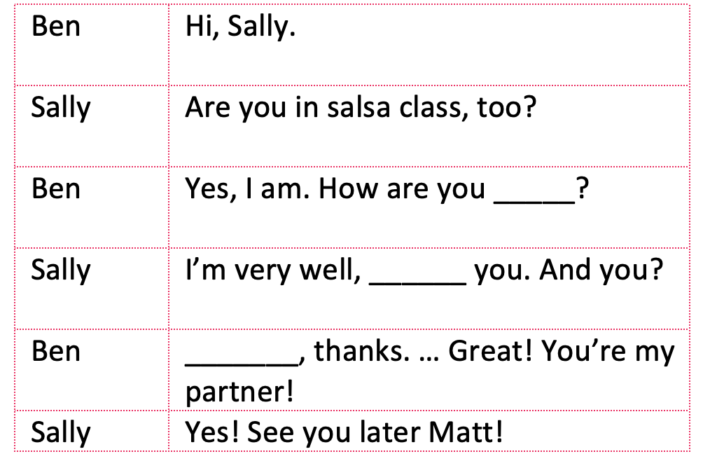
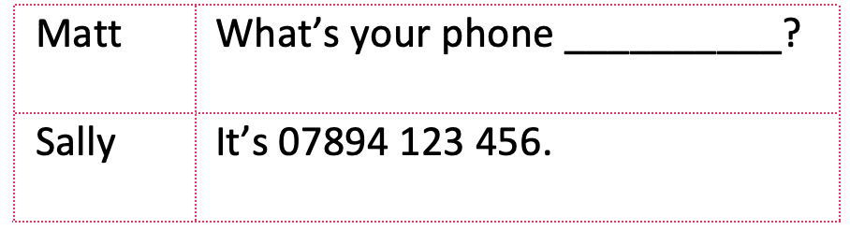
4
1
Listen
and Complete
2
5
3
Notes:
Listen the recording and then T writes on the screen using the “annotate” option on Zoom.. Give students time to listen and write down the answers. Recording 1

Slide 21
So, as you can notice…
Fine Hi I’m… Thanks Bye
Hello
My name’s
Very well
Thank you
Goodbye
________
________
________
________
________
=
Notes:
T explains that there are several ways to say it. T asks ss to match them and pronounce them. You can this as a whole group or in small groups.

Slide 22

Introductions

Slide 23
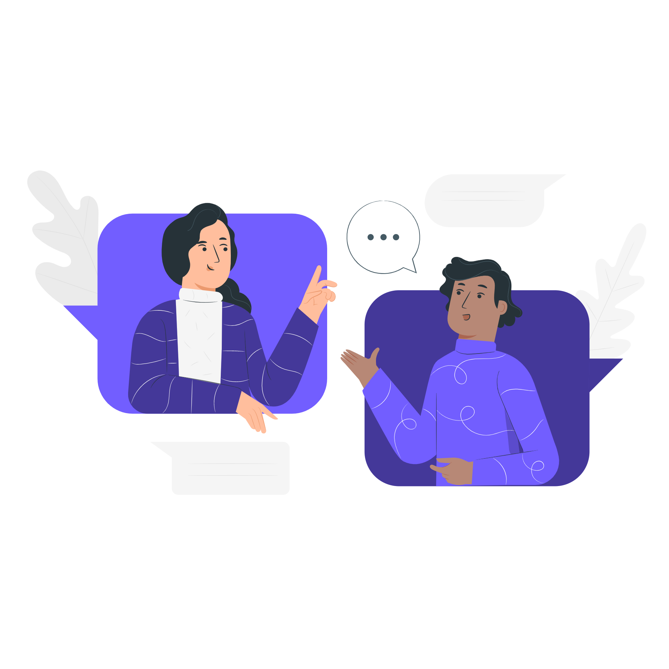
Pronunciation and Intonation
Listen to the recording and pay special attention to their intotation. Pronounce for yourself.
Talk made by StorySet> <a href="https://storyset.com/online">Illustration by Freepik Storyset</a>
In the next group activity, you will try to copy the rhythm
Notes:
REcording 2

Slide 24
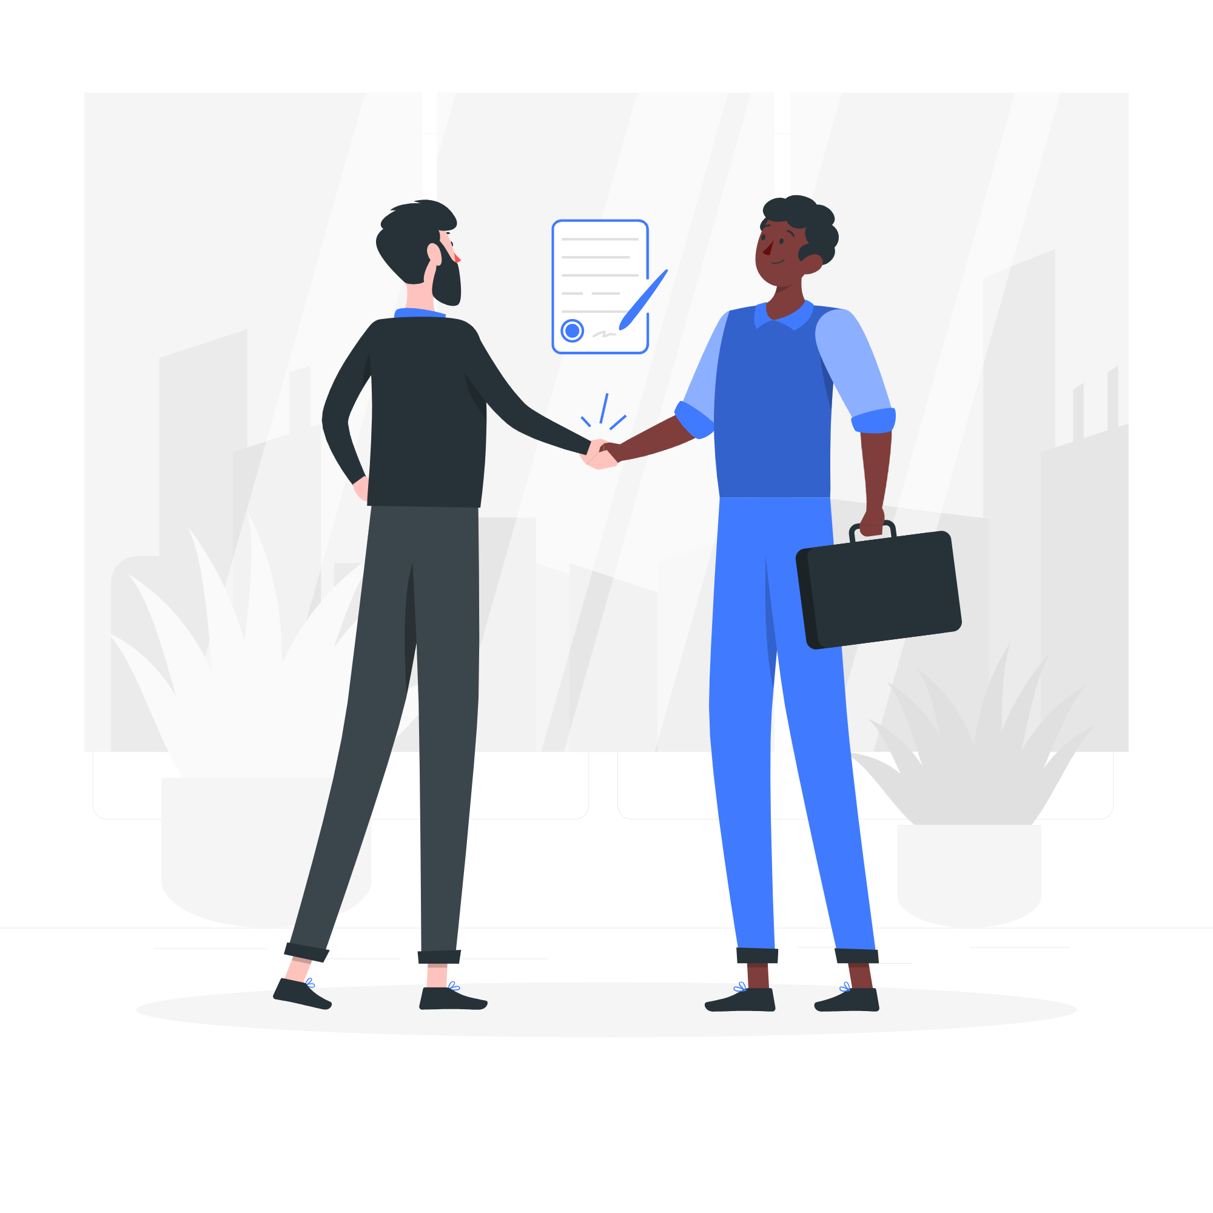
What about business etiquette?
Shake hand?
Exchange business cards?
Bow?
<a href="https://storyset.com/business">Illustration by Freepik Storyset</a>
Notes:
Guiding questions: Is it common to exchange business cards?
Do people shake hands? What about during Covid?

Slide 25
In business communication..
Use titles (Mr, Ms, Mrs, etc.)
Be formal and avoid informal language (unless you are talking to a friend)
In written or spoken language, say hello and goodbye in a formal manner.
<a href="https://storyset.com/business">Illustration by Freepik Storyset</a>
Notes:
T explains

Slide 26
Titles: Matching
Mr
A married woman
Mrs
A married or single woman
Dr
A man
Mr and Ms
Someone with a PhD or a medical doctor
Notes:
Here, T asks students to match and as they go, T explains.

Slide 27
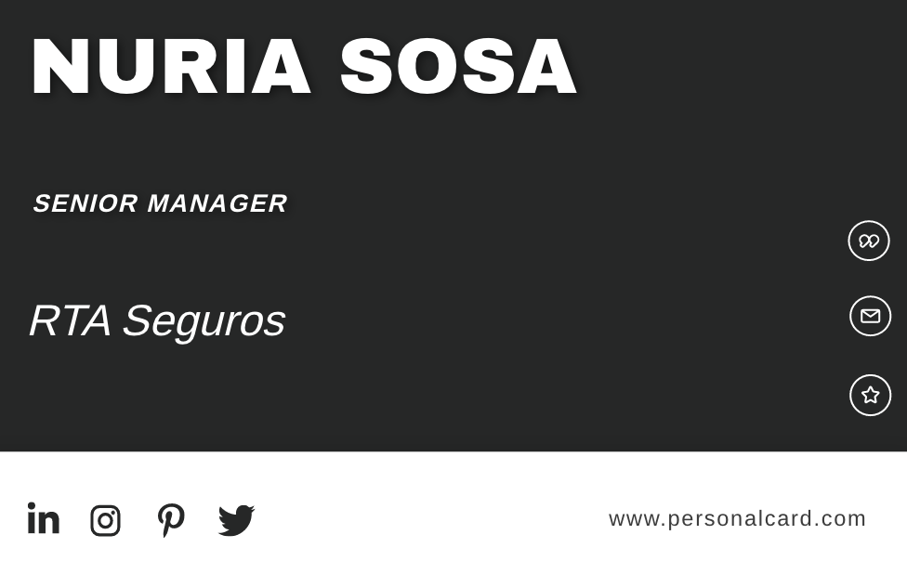
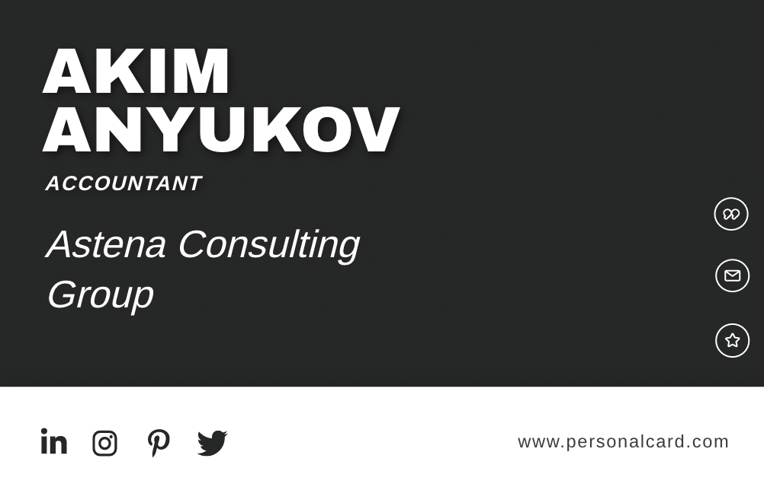
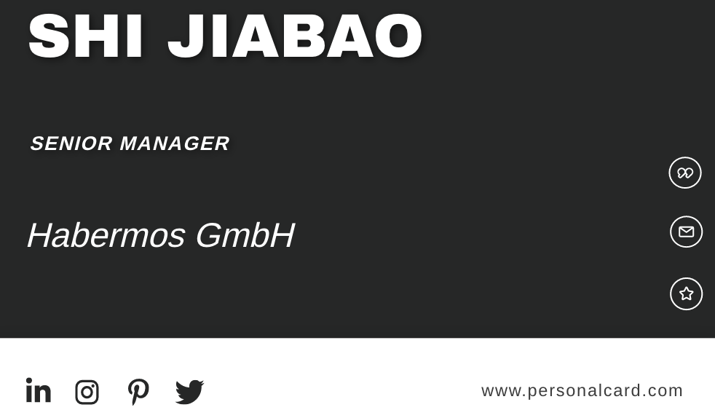
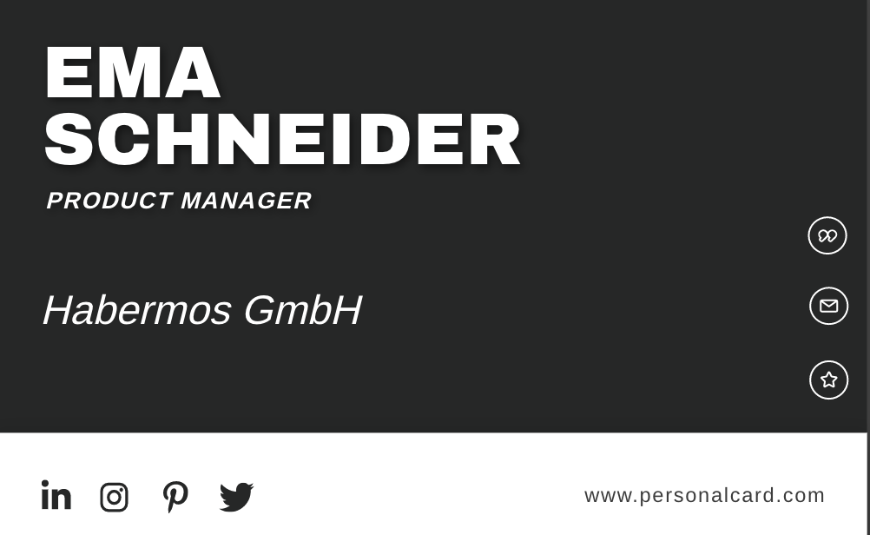
Listen
____
B. ____
Step 1. Listen to a recording of business people introducing themselves.
Step 2. Match the recordings with the business cards of each person.
Step 3. Mark the expressions that you hear.
C. ____
D. ____
_____Nice to meet you
_____Please to meet you
_____I didn’t catch your name.
_____Good evening.
_____ Hello
Notes:
T explains

Slide 28

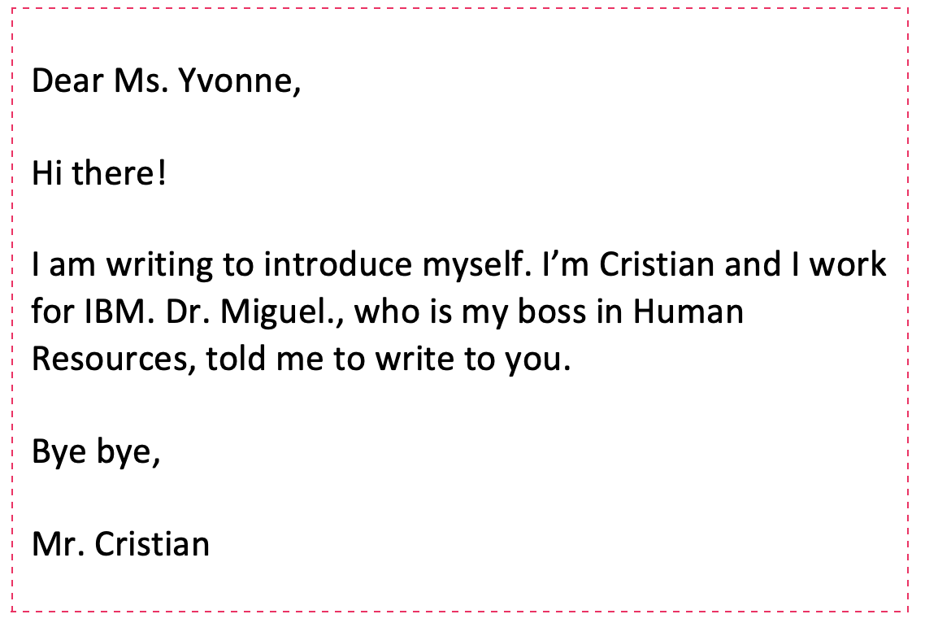
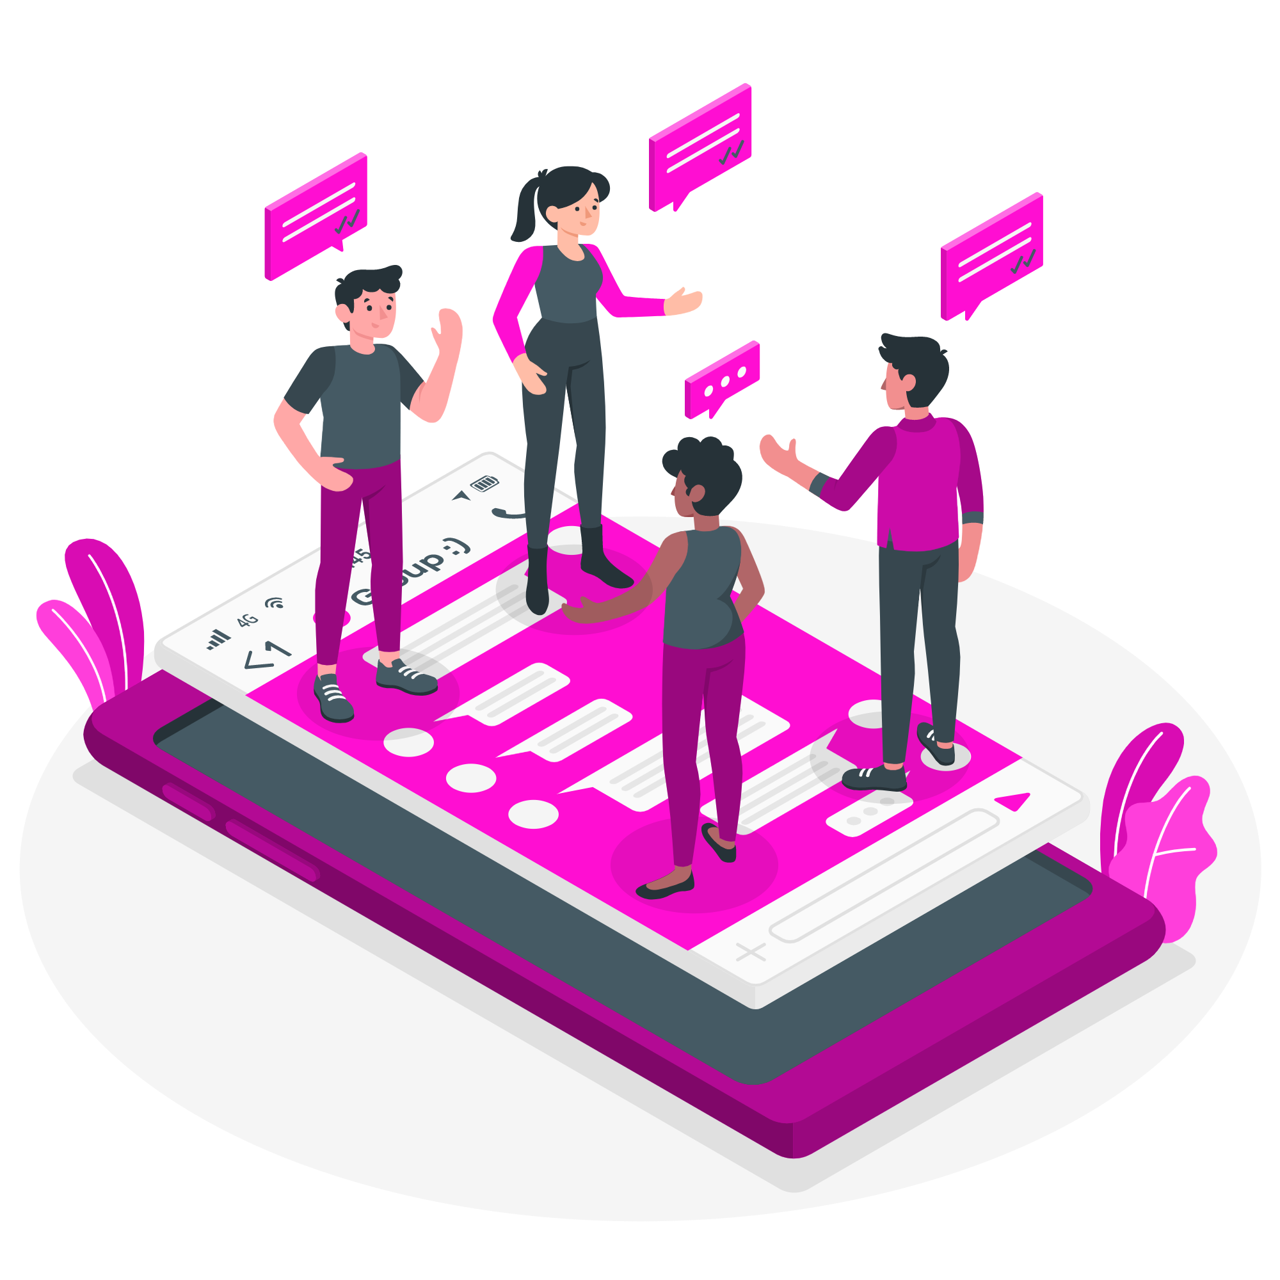
Group work: Let’s correct some common mistakes
10 min
Group made by StoruSet: <a href="https://storyset.com/social-media">Illustration by Freepik Storyset</a>
Notes:
After SS have finished, T brings them back into the main room and they correct together. As they correct, T uses ANNOTATION on Zoom and explains WHY each mistake is a mistake.

Slide 29
Group work: Let’s correct some common mistakes
Title Ms goes only with surnames.
10 min
Very informal
Dr is used with surnames and only for PhD or medical doctors.
Group made by StoruSet: <a href="https://storyset.com/social-media">Illustration by Freepik Storyset</a>
Very informal. Use: Best,
Mr is used only with surnames- never names. Sign off with your first name only.
Notes:
After SS have finished, T brings them back into the main room and they correct together. As they correct, T uses ANNOTATION on Zoom and explains WHY each mistake is a mistake.

Slide 30
Language Focus: Pronouns
I am Juan.
You are Nathalia.
He is an engineer.
She is from Bogotá.
It is pronounced COU-DING.
We work in MinTic.
You are Tatiana.
They are programmers.
My name is Juan.
Your name is Nathalia.
His job is engineering.
Her city is Bogotá
Its pronunciation is COU-DING.
Our ministry is MinTic.
Your name is Tatiana
Their job is programming.

Slide 31
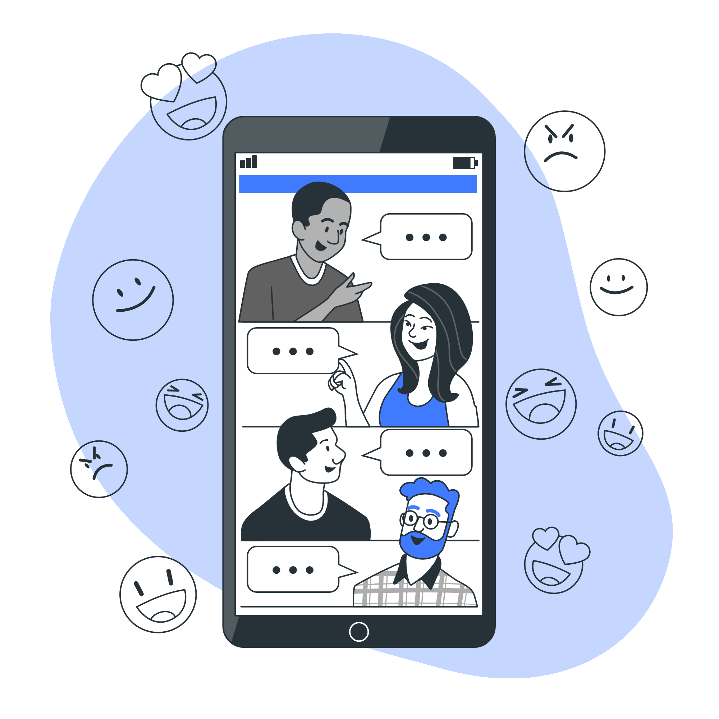
Task 1
Work in small groups. Practice introductions
1 Introduce yourself
2 Introduce of of your team member/classmates (only 1).
3 Be careful with pronunciation, titles and pronouns.
Time: 5-8 min
Chat made by StorySet> <a href="https://storyset.com/social-media">Illustration by Freepik Storyset</a>

Slide 32
Greetings: Task 1
How did it go?
Chat made by StorySet> <a href="https://storyset.com/social-media">Illustration by Freepik Storyset</a>
Notes:
T asks one or 2 groups to act out.

Slide 33

Dream Jobs

Slide 34

Dream job: Task 2
Instructions for group work:
Step 1: One person shares the screen so every student can see the template.
Step 2: From the dream jobs you mentioned in the warm up activity today, agree on 1 only as the best one.
Step 3: Think of a person who has that job. Look him/her up online and prepare a poster using the template.
Step 4. Be ready to present your poster to the group.
Time: 10-15 min
Career progress Semi Flat Illustrations
made by StorySet : <a href="https://storyset.com/business">Illustration by Freepik Storyset</a>

Slide 35
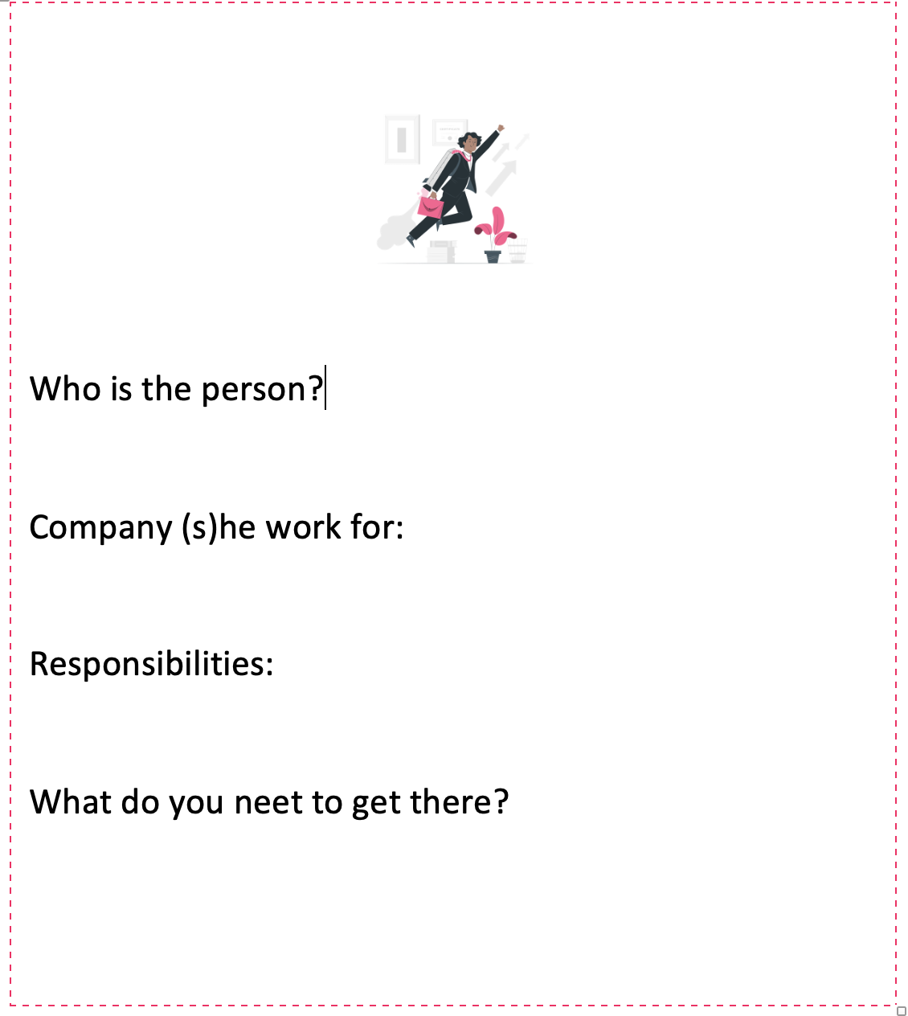
Dream Job Template Card

Slide 36
Dream job: Presentations
Career progress Semi Flat Illustrations
made by StorySet : <a href="https://storyset.com/business">Illustration by Freepik Storyset</a>
Notes:
T asks volunteers to share screen and show their cards and present in English. 3 presentations maximum.

Slide 37

Wrap up
Today, you learnt how to…
Introduce yourself.
Introduce others.
Greet in a formal and informal manner.
Done made by StorySet. <a href="https://storyset.com/work">Illustration by Freepik Storyset</a>

Slide 38

Autonomous Asynchronous work
MasterTech Platform: My Learning Menu 1
1 Appetizers (optional)
Whole Main Course (Important)
1 Dessert(optional)
Homework Semi Flat Illustrations
made by StorySet <a href="https://storyset.com/education">Illustration by Freepik Storyset</a>

Slide 39
See you in our next class when you will learn:
Occupations
Nationalities
Online made by StorySEt> <a href="https://storyset.com/online">Illustration by Freepik Storyset</a>

Slide 40
Thank you

